Slide 1
Cognitive Toolkit (CNTK) Cha Zhang, Principal Researcher Microsoft AI & Research
With 150+ contributors

Slide 2
Cognitive Toolkit (CNTK)
Microsoft’s open-source deep-learning toolkit
https://github.com/Microsoft/CNTK
Created by Microsoft Speech researchers in 2012, “Computational Network Toolkit”
On GitHub since Jan 2016 (MIT license)
13,000+ GitHub stars
150+ contributors from MIT, Stanford, Nvidia, Intel and many others
Internal == External

Slide 3
Cognitive Toolkit
1st-class on Linux and Windows, docker support
Rich API support
Mostly implemented in C++ (train and eval)
Low level + high level Python API
R and C# API for train and eval
UWP, Java and Spark support
Keras backend support (Beta)
Model compression
Part of ONNX ecosystem
Latest version: v2.3.1 (Dec. 5, 2017)

Slide 4
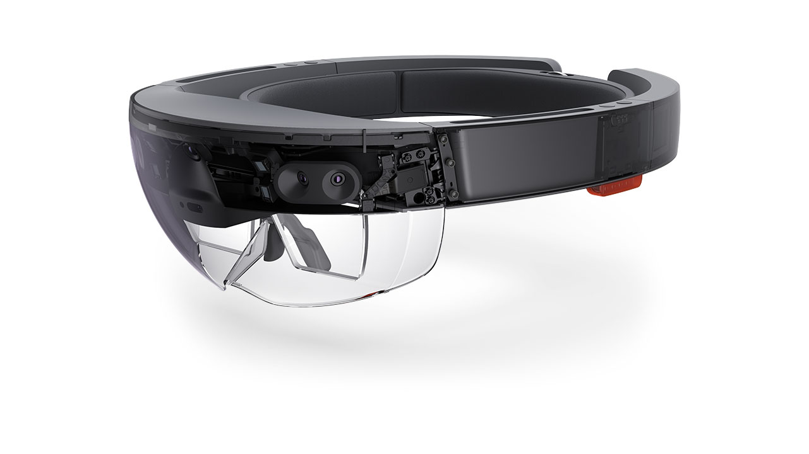
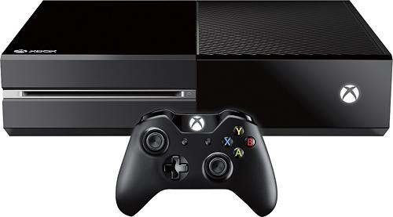
CNTK inside Microsoft
Bing
Cortana
HoloLens
Office
Skype
Cognitive Services
Microsoft Research

Slide 5
CNTK Latest Features (v2.2, v2.3)
New tutorials/examples/manuals
NCCL2 support
MKL-DNN integration
ONNX support
C#/.NET API
R-binding for CNTK
Model simplification/compression support
New ops and perf-improvements
Tensorboard support

Slide 6
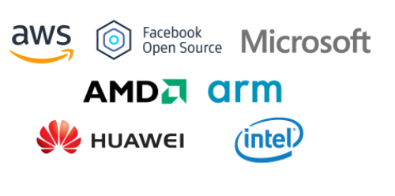
Open Neural Network Exchange (ONNX)
ONNX is an open format to represent deep learning models
Supported by:
CNTK
PyTorch
Caffe 2
MxNet
Enabled interop-ability between frameworks
For more information: https://onnx.ai/

Slide 7
ONNX Motivation
Allow interoperability between frameworks
Allow hardware vendor to focus on one IR in their backend optimization
Allow train in one toolkit and deploy in another

Slide 8
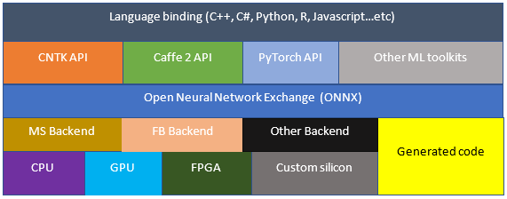
ONNX Vision

Slide 9
ONNX Status in CNTK
V1 release in Github, focus on the basics
Support only inference, no loop, no condition and no gradient
Supported by CNTK, Caffe2, PyTorch and MxNet
Upcoming work:
Refined RNN support
Loop and control
Converter for other toolkits are coming soon

Slide 10
Q&A http://cntk.ai https://github.com/Microsoft/CNTK https://onnx.ai

